Slide 1
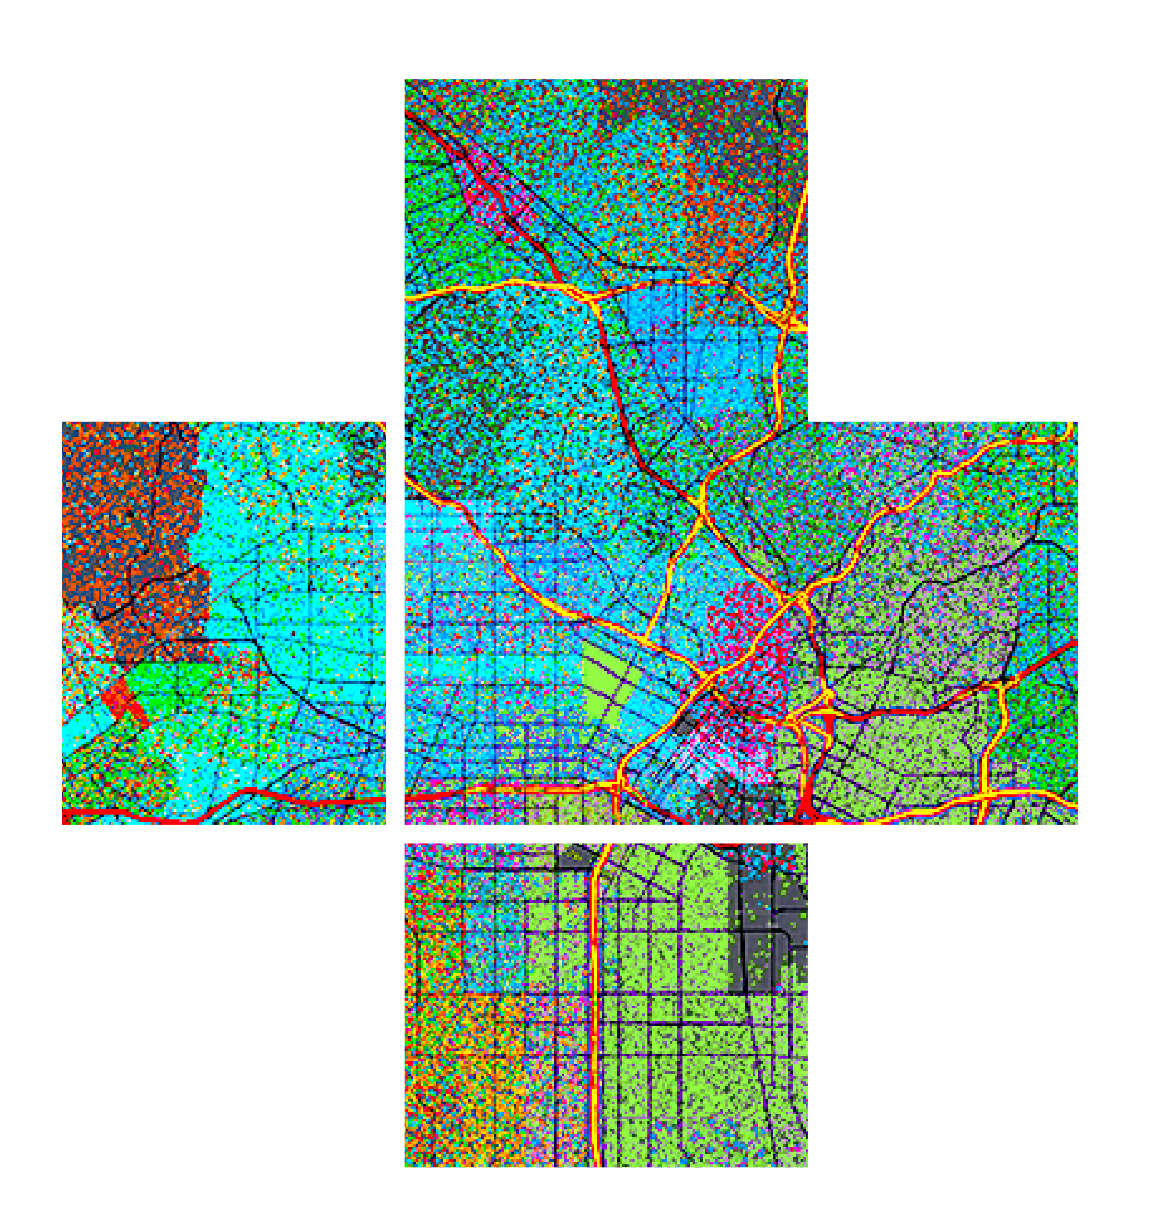








Best practices for building web apps that visualize large datasets
Please leave artwork “+” clustered.
Do not use them alone, as bullet points, or as a “plus” concept. Thank you.
Jeremy Bartley & Kristian Ekenes
2020 ESRI DEVELOPER SUMMIT | Palm Springs, CA

Slide 2


Considerations before you start development
Jeremy Bartley

Slide 3


Considerations before you start development
Know your audience
Just a few specialized users?
Public or private?
Potential to go viral?
Devices
Desktop only?
Mobile and tablets
Generalization
Choose an appropriate geometry type for scale
Reduce number of features
Reduce vertices
Notes:
Show the playground here

Slide 4
Behind the scenes
What the JS API & ArcGIS platform do for you

Slide 5
JS API and platform efficiency
Cacheable feature tiles
Pbf queries
Quantization
Compression
Dynamic attribute requests
Notes:
Show the playground here

Slide 6
Visualization techniques
Kristian Ekenes

Slide 7
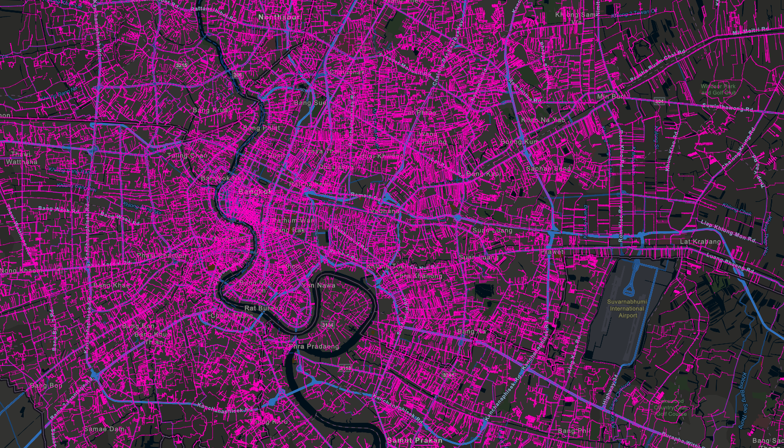


Water distribution pipes

Slide 8
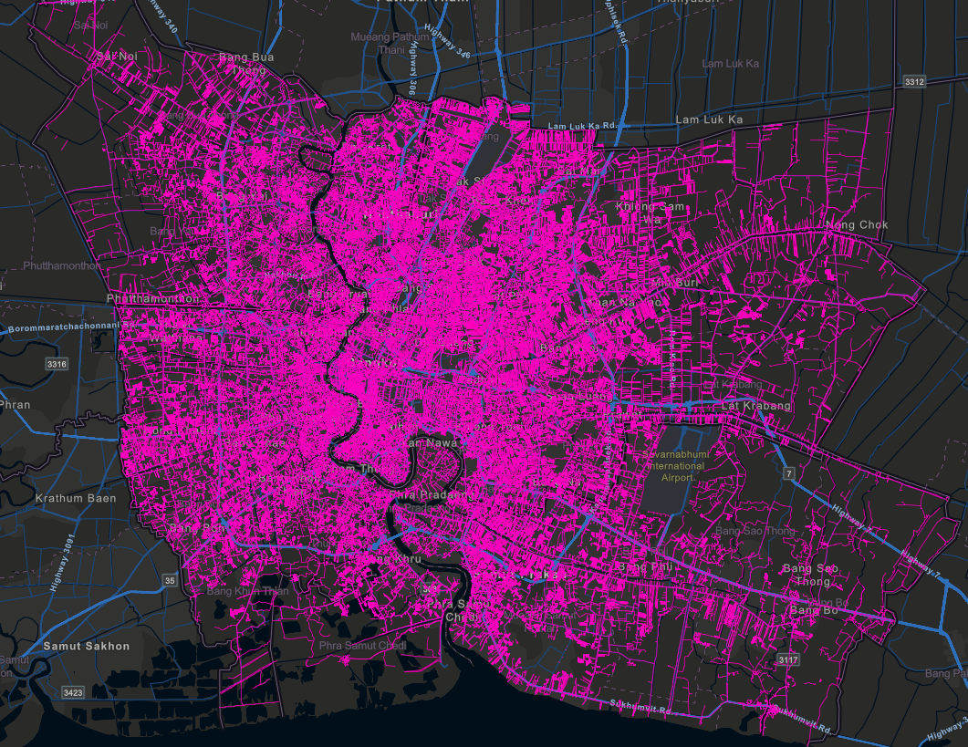
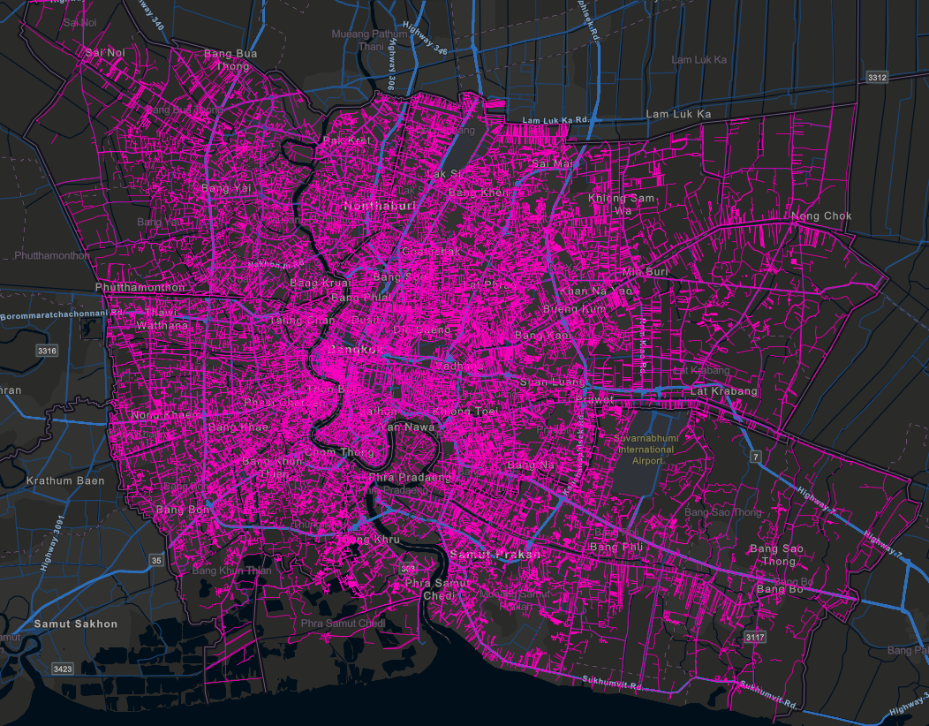
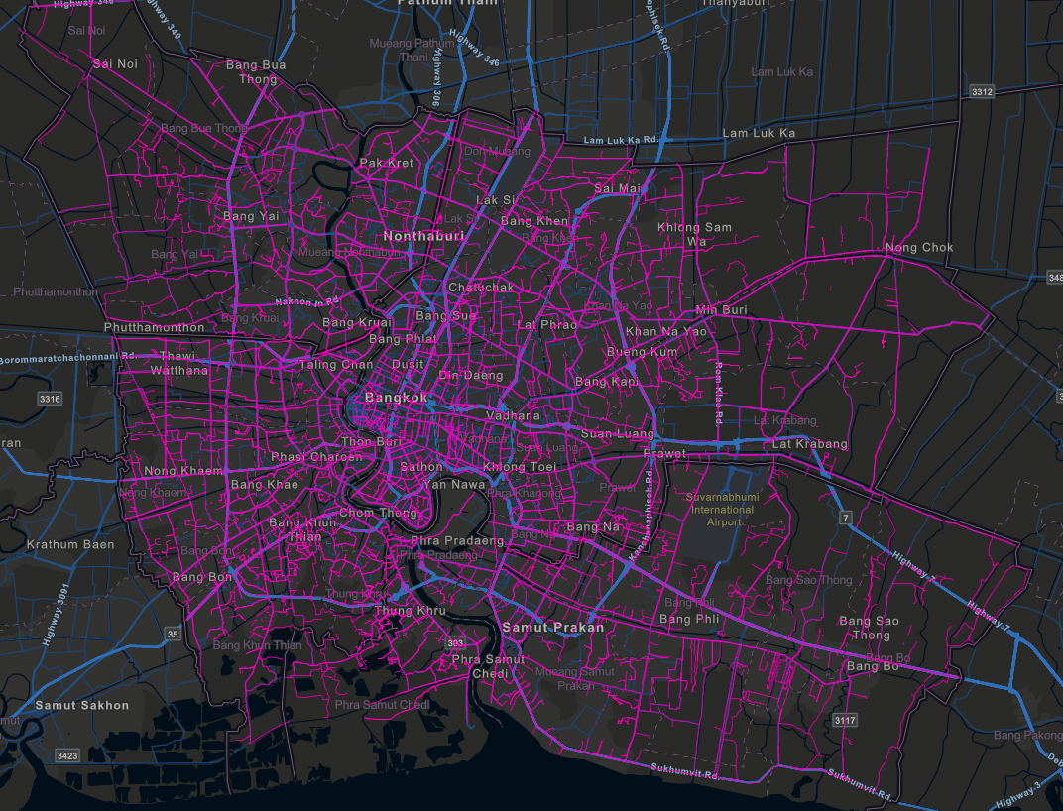
Filter by scale
No filter
17.7 MB
~7s (desktop on fast network)
Filter: pipe_size >= 150
14.7 MB
~5s (desktop on fast network)
Filter: pipe_size >= 300
11.2 MB
~3s (desktop on fast network)
Notes:
Show the playground here

Slide 9
Before you start
Jeremy Bartley

Slide 10
Symbols
Notes:
Show the playground here

Slide 11
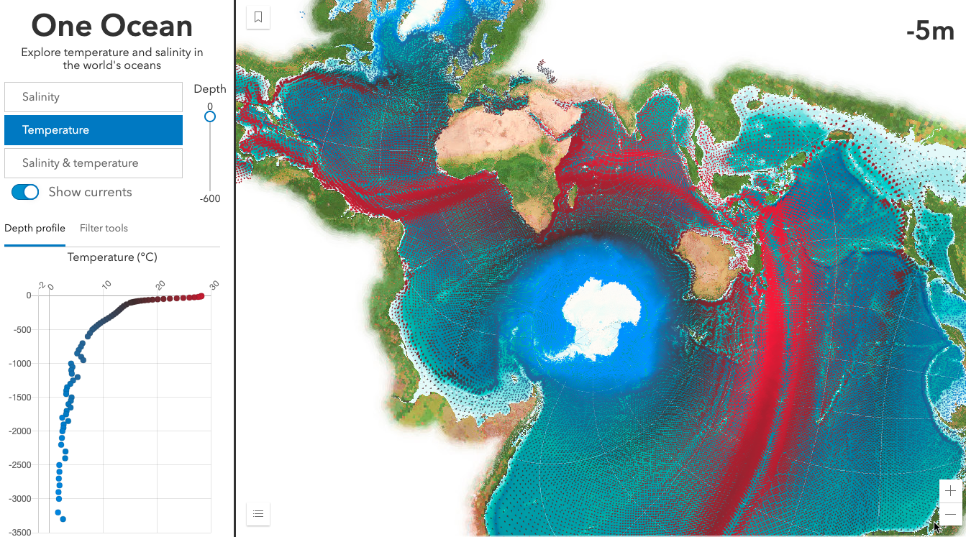
One Ocean
Kristian Ekenes

Slide 12


